Slide 1
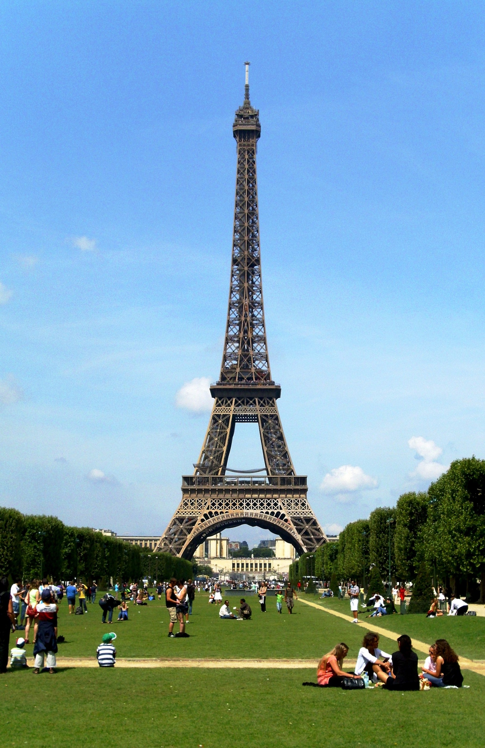




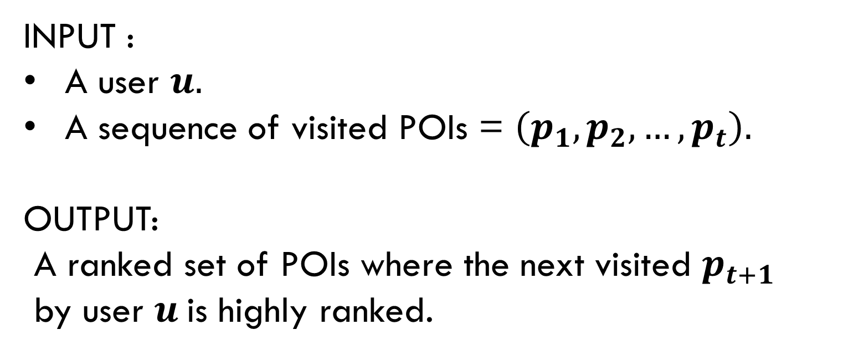
NEXT POINT OF INTEREST RECOMMENDATION WITH
GRAPH RECURRENT NETWORK AND BEAM SEARCH
INPUT :
A user $u.$
A sequence of visited POIs = $\left(p_{1}, p_{2}, …, p_{t}\right).$
OUTPUT:
A ranked set of POIs where the next visited $p_{t+1}$
by user $u$is highly ranked.

Slide 2
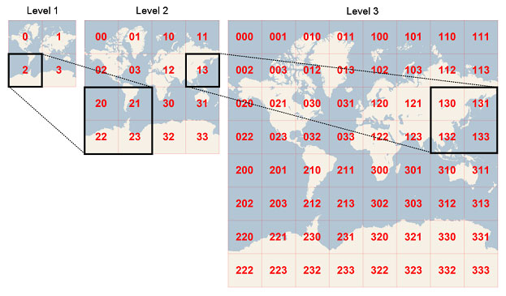
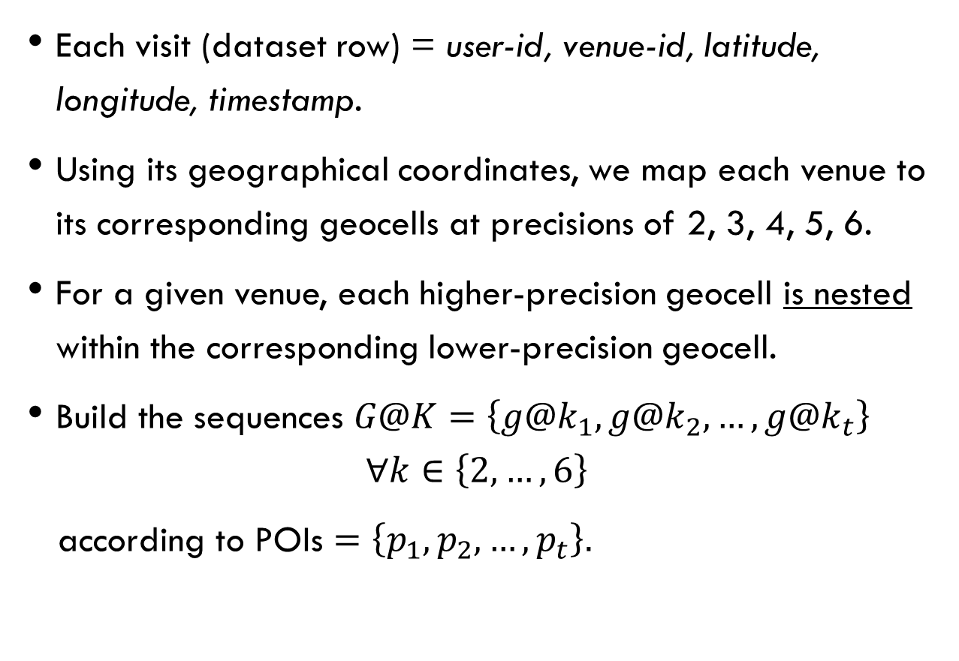
GeoHash Cells
Each visit (dataset row) = user-id, venue-id, latitude, longitude, timestamp.
Using its geographical coordinates, we map each venue to its corresponding geocells at precisions of 2, 3, 4, 5, 6.
For a given venue, each higher-precision geocell is nested within the corresponding lower-precision geocell.
Build the sequences $G@K=\left\{g@k_{1}, g@k_{2},…, g@k_{t}\right\}$
$$∀k∈\left\{2,…,6\right\}$$
according to POIs $=\left\{p_{1}, p_{2},…, p_{t}\right\}.$

Slide 3
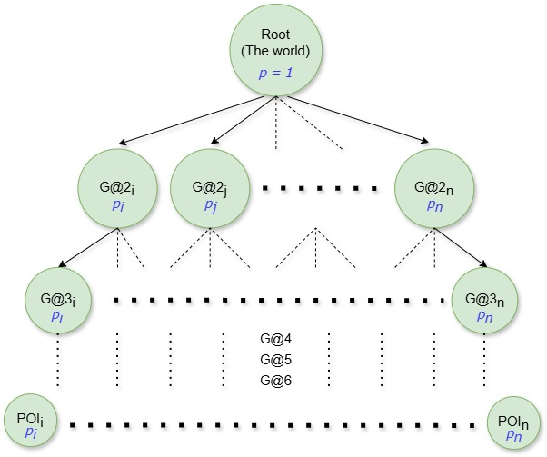
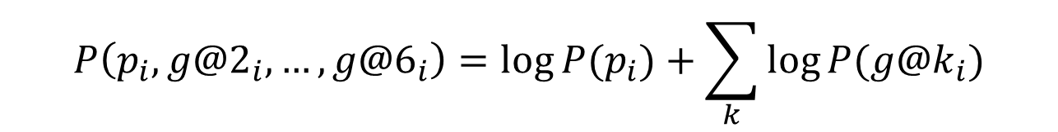
Geo-Hierarchical Tree
Each node in the tree represents a geocell. Nodes at a particular level represent geocells of the same precision.
Nodes at a higher precision level are children of nodes at the immediate lower precision level if they are geographically contained within the parent node’s area.
This continues down to the leaves representing individual POIs.
$$P\left(p_{i}, g@2_{i},…,g@6_{i}\right)=\log{P(p_{i})}+\sum_{k}{\log{P(g@k_{i})}}$$

Slide 4
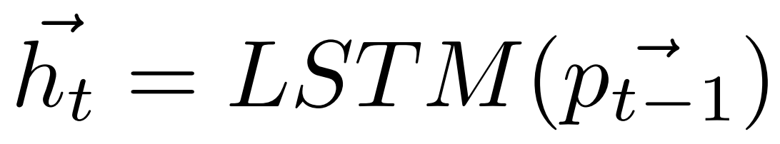
Baseline: HMT-RN
Map the user, previously visited POI and corresponding geocells to a vector representation via a learnable embedding layer:
An LSTM layer to learn the sequential dependencies among the POI sequence:
Finally, we compute the probabilities of the next POI distribution as:

Slide 5
Baseline: HMT-RN
Similarly, we model the distribution of GeoHash cell at each precision.
Considering the grid cell of a specific precision associated to the previous visited POI to compute the probability of the next grid cell at the same precision.

Slide 6
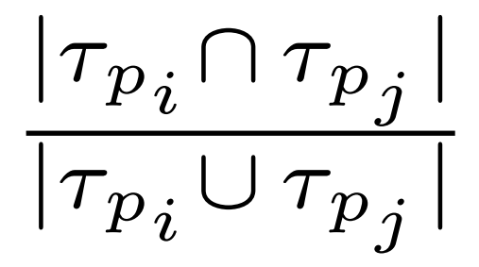
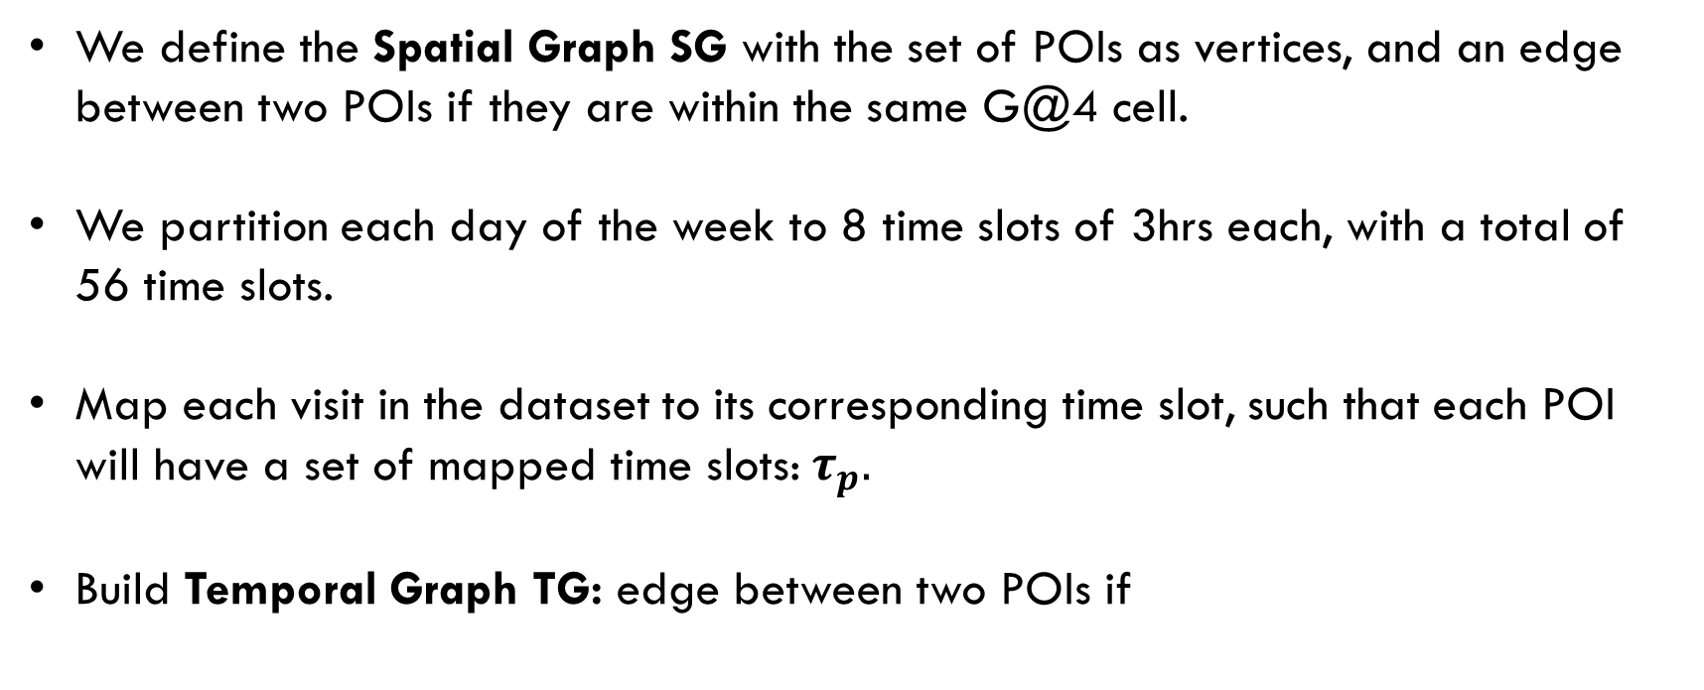
Spatial & Temporal Graphs
We define the Spatial Graph SG with the set of POIs as vertices, and an edge between two POIs if they are within the same G@4 cell.
We partition each day of the week to 8 time slots of 3hrs each, with a total of 56 time slots.
Map each visit in the dataset to its corresponding time slot, such that each POI will have a set of mapped time slots:${ τ}_{p}.$
Build Temporal Graph TG: edge between two POIs if
≥ 0.9

Slide 7
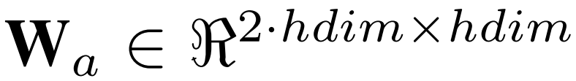
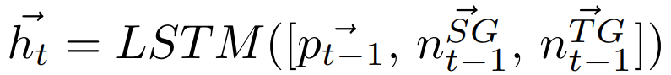
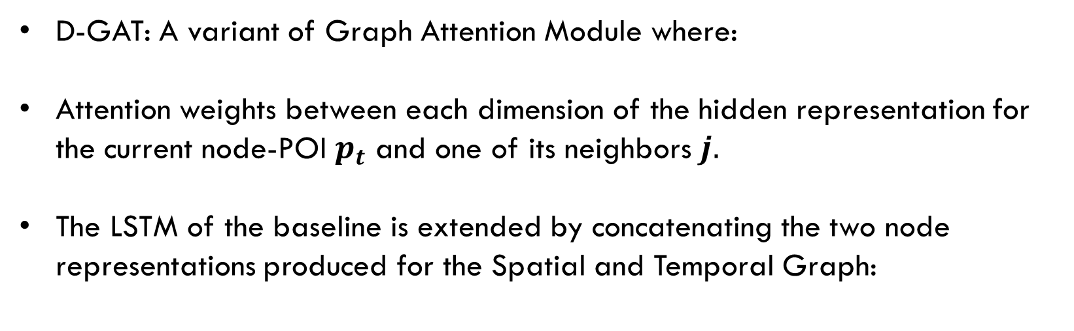
The model: HMT-GRN
D-GAT: A variant of Graph Attention Module where:
Attention weights between each dimension of the hidden representation for the current node-POI $p_{t}$ and one of its neighbors $j.$
The LSTM of the baseline is extended by concatenating the two node representations produced for the Spatial and Temporal Graph:

Slide 8
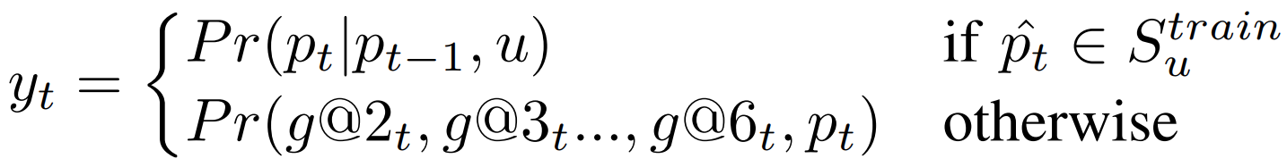
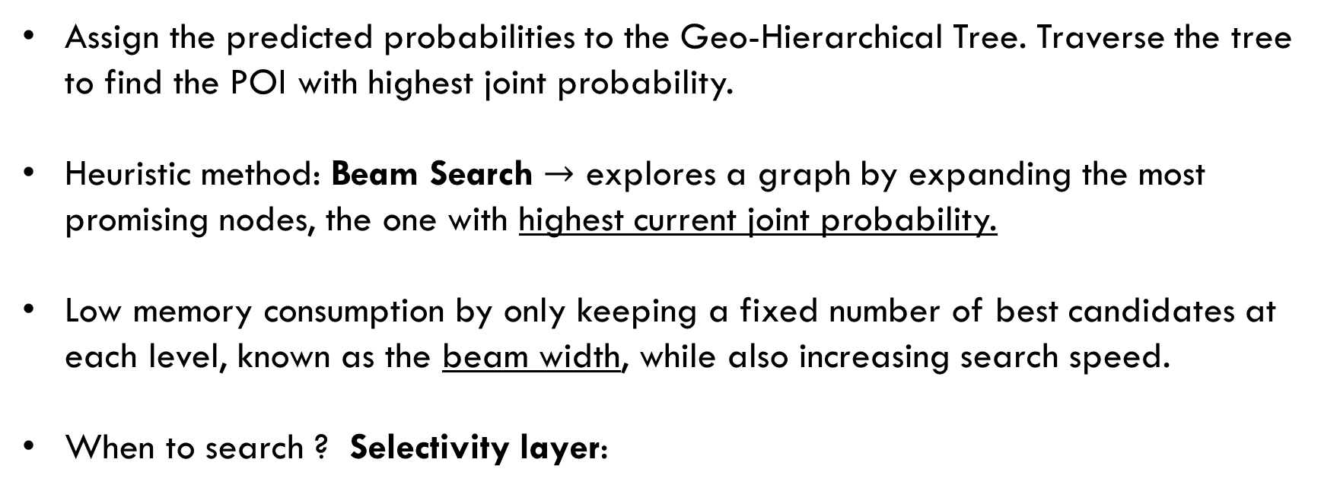
GeoTree search strategies
Assign the predicted probabilities to the Geo-Hierarchical Tree. Traverse the tree to find the POI with highest joint probability.
Heuristic method: Beam Search $→$ explores a graph by expanding the most promising nodes, the one with highest current joint probability.
Low memory consumption by only keeping a fixed number of best candidates at each level, known as the beam width, while also increasing search speed.
When to search ? Selectivity layer:

Slide 9
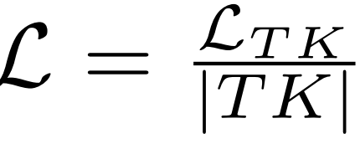
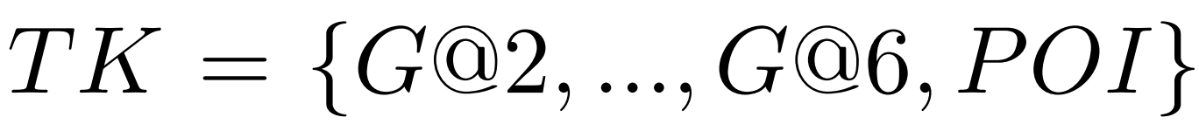
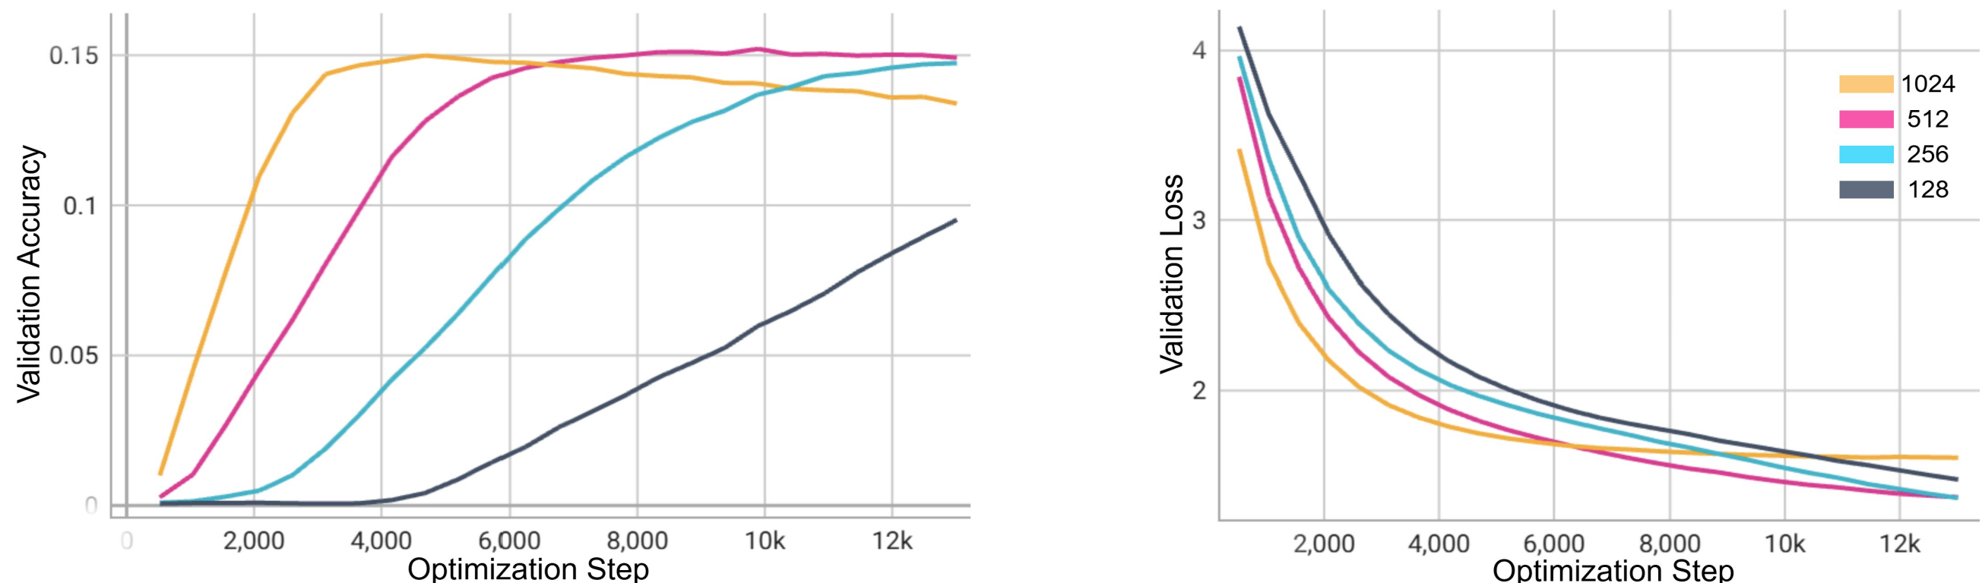
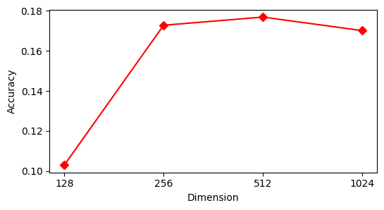
Training:
Multitask loss: ;
Cross-Entropy loss for tasks from G@4 to POI.
Focal Loss for tasks G@2, G@3 due to strong imbalance.
Validation accuracy (raw POI task) of the best model of each size.
Performance during training for different hdim and embedding sizes.

Slide 10
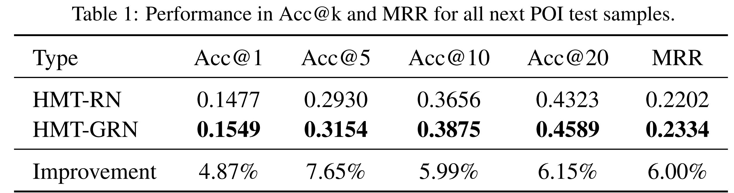
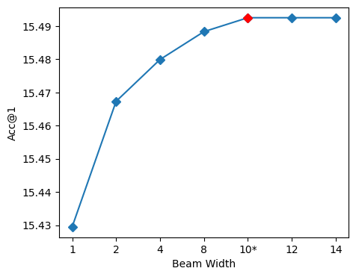
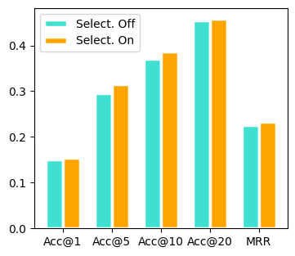
Final results with BeamSearch
Impact of Beam Width choice and selectivity layer:

Slide 11


Thank you for the attention
Made with DALL-E 3

